Slide 1
Lang Chain for LLM Apps
Palani Karthikeyan

Slide 2
Langchain
Created in 2022 by Harrison Chase, LangChain is an open-source Python framework for building LLM-powered applications.
It provides developers with modular, easy-to-use components for connecting language models with external data sources and services.

Slide 3
Langchain
LangChain simplifies the development of sophisticated LLM applications by providing reusable components and pre-assembled chains.
Its modular architecture abstracts access to LLMs and external services into a unified interface.
Developers can combine these building blocks to carry out complex workflows.

Slide 4
Langchain
The key benefits LangChain offers developers are:
Modular architecture for flexible and adaptable LLM integrations.
Chaining together multiple services beyond just LLMs.
Goal-driven agent interactions instead of isolated calls.
Memory and persistence for statefulness across executions.
Open-source access and community support.

Slide 5
Exploring key components of LangChain
Chains
Agents
Memory and tools

Slide 6
Chain
A Chain is an abstraction that ties together multiple components, such as:
Prompts
LLMs (Language Models)
Memory (for context across interactions)
Tools or retrievers (e.g., search, calculator)
Other chains (chains can be nested)
Each chain takes inputs, performs transformations or reasoning, and produces outputs

Slide 7
Types of Chains in LangChain
Chain Type | Description
LLMChain | The most basic chain: a prompt + an LLM.
SequentialChain | A sequence of chains that run one after another. Output from one is passed to the next.
SimpleSequentialChain | Like SequentialChain, but all intermediate outputs are not exposed.
ConversationChain | Adds memory so the model remembers previous interactions.
RetrievalQAChain | Combines a retriever (like vector store search) and a question-answering step.
MapReduceChain | Processes documents in parallel, then combines results (used in RAG).
RouterChain | Directs inputs to different sub-chains based on conditions or content.

Slide 8
Example
from langchain.chains import LLMChain
from langchain.llms import OpenAI
from langchain.prompts import PromptTemplate
llm = OpenAI()
prompt = PromptTemplate.from_template("What is a good name for a company that makes {product}?")
chain = LLMChain(llm=llm, prompt=prompt)
response = chain.run(product="sports shoes")
print(response)

Slide 9
Example
llm = OpenAI()
prompt = PromptTemplate.from_template("What is a good name for a company that makes {product}?")
⬅ format the prompts
chain = LLMChain(llm=llm, prompt=prompt) ⬅ Send to LLM
response = chain.run(product="sports shoes") ⬅ Takes the input
print(response) ⬅ prints the result

Slide 10
Agents
An Agent is a controller that:
Uses an LLM to interpret user input
Decides what actions to take (e.g., search, calculate, call an API)
Uses tools (also called "tools" or "functions") to get information
May take multiple steps, iterating until it finds the final answer.

Slide 11
Agents
Agent Workflow
Repeats if needed, until it can produce a final answer
Receives user input
Thinks: What do I need to do to answer this?
Chooses a tool (e.g., a calculator or web search)
Executes the tool with appropriate input
Interprets the output

Slide 12
Difference from a Chain
Feature | Chain | Agent
Steps | Fixed sequence | Dynamic, based on reasoning
Tools | Optional, static | Actively chosen at runtime
Suitable for | Straightforward workflows | Multi-step tasks with decisions
Flexibility | Low | High

Slide 13
Example
from langchain.agents import initialize_agent, load_tools
from langchain.llms import OpenAI
# Load LLM and tools
llm = OpenAI(temperature=0)
tools = load_tools(["serpapi", "llm-math"], llm=llm)
# Initialize the agent
agent = initialize_agent(tools, llm, agent="zero-shot-react-description", verbose=True)
# Ask the agent a question
response = agent.run("What is the square root of the population of France?")
print(response)

Slide 14
Types of Agents
Agent Type | Description
zero-shot-react-description | Most common: LLM uses reasoning and chooses tools
react | Uses specific prompt structure for step-by-step reasoning
plan-and-execute | Separates planning and execution (for complex tasks)
openai-functions | Uses OpenAI function calling API (structured tool use)

Slide 15
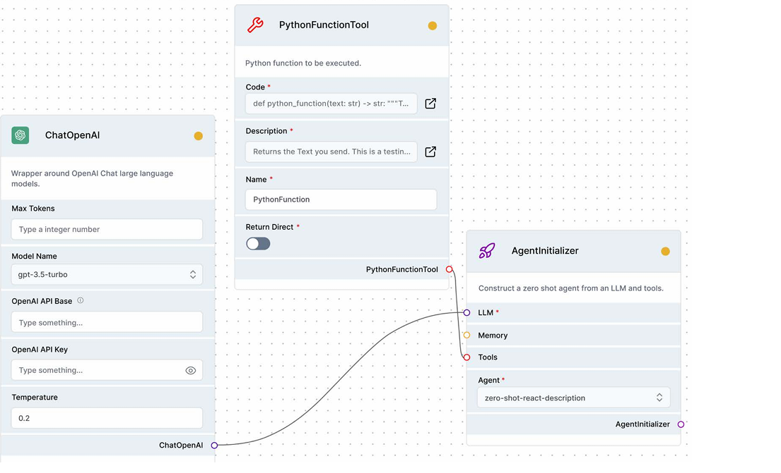
A simple LLM app with a Python function visualized in LangFlow

Slide 16
Memory
In LangChain, Memory is a component that allows conversations or chains to remember information across interactions — just like human memory in a conversation.

Slide 17
Memory
Memory stores and retrieves information between calls to the chain or agent. It enables:
Conversational continuity (remembering what was said before)
Context-aware reasoning (like remembering the user's name or preferences)
Task tracking (recalling steps or facts from earlier)

Slide 18
Types of Memory in LangChain
Memory Type | Description
ConversationBufferMemory | Stores all messages in memory (no summarization)
ConversationSummaryMemory | Summarizes chat history with the help of an LLM
ConversationBufferWindowMemory | Keeps only the last k messages (a sliding window)
ConversationTokenBufferMemory | Retains history within a token limit (for LLM constraints)
VectorStoreRetrieverMemory | Stores memory as embeddings (semantic memory)
ReadOnlySharedMemory | Shares memory across chains but in read-only mode

Slide 19
How It Works
User sends a message (e.g., "My name is Alice.")
Memory saves it (e.g., stores: {"name": "Alice"})
Later message: "What's my name?"
The chain or agent uses memory to include prior context in the prompt.
LLM answers: "Your name is Alice."

Slide 20
Example: ConversationBufferMemory
from langchain.chains import ConversationChain
from langchain.memory import ConversationBufferMemory
from langchain.llms import OpenAI
llm = OpenAI()
memory = ConversationBufferMemory()
conversation = ConversationChain(llm=llm, memory=memory, verbose=True)
print(conversation.run("Hi, I'm Bob."))
print(conversation.run("What's my name?"))
> Entering new ConversationChain chain...
Hi Bob! How can I help you today?
...
> Entering new ConversationChain chain...
Your name is Bob.

Slide 21
When to Use Memory
Use Case | Memory Type
Simple chatbot with full history | ConversationBufferMemory
Chatbot that avoids prompt length issues | ConversationSummaryMemory
Agent with semantic memory of facts | VectorStoreRetrieverMemory
Performance-focused apps | ConversationBufferWindowMemory or token-limited memory

